Slide 1
Implementation of a Total Power Radiometer in Software Defined Radios
Matthew E. Nelson
Iowa State University
Electrical and Computer Engineering

Slide 2
Acknowledgements
POS Committee
Dr. Phillip Jones, Dr. Mani Mina, Dr. John Basart
Additional Support
Dr. Brian Hornbuckle
Special Thanks
My wife, Jennifer and my family for their support

Slide 3
Table of Contents

Slide 4
Introduction
The goal of this presentation is to present my research into implementing a total power radiometer using low cost hardware and software used in software defined radios.
This thesis looks to explore the following questions:
Can we use a SDR to recreate a radiometer in software?
If so, what performance can we get from the system?
Can we create a low cost SDR Radiometer that is effective?
What benefits do we obtain by using a SDR Radiometer?

Slide 5
About the thesis
The goal of this thesis is to explore a low cost method for implementing a total power radiometer using a software defined radio and to demonstrate the effectiveness and benefits of this system.
Why a SDR?
A software defined radio infrastructure provides a highly flexible system that is able to adapt to different scenarios more quickly and at a lower cost than traditional radiometers

Slide 6
Related Works
Radio Astronomy
Radiometers are used in a variety of remote sensing applications such as soil moisture and ocean salinity
Radio Astronomy is one method of using radiometers for remote sensing
There are current stations using Software Defined Radios for Radio Astronomy
Notes:
Radiometers are used in remote sensing of soil, ocean and deep space. SMOS is an excellent example of a working soil and ocean measurement system.

Slide 7
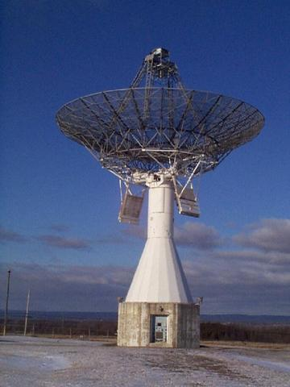
Related Works
The Shirleys Bay Radio Astronomy Consortium (SBRAC) located in Smiths Falls, Ontario is currently using a USRP software defined radio in conjunction with GNURadio
Notes:
Marcus is the Principal Investigator at SBRAC and also a contributor to the radiometer branch in GNURadio. Although this branch is no longer maintained, he still answers questions about using radiometers with GNURadio SBRAC has successfully used this configuration to obtain radio astronomy data by looking at the hydrogen line at 1420.4058 MHz. The person in charge of this facility, Marcus Leech, contributed software to the GNURadio specifically for radio astronomy applications. It was this software branch that was used as the base for the GNURadio program that was used in this thesis.

Slide 8
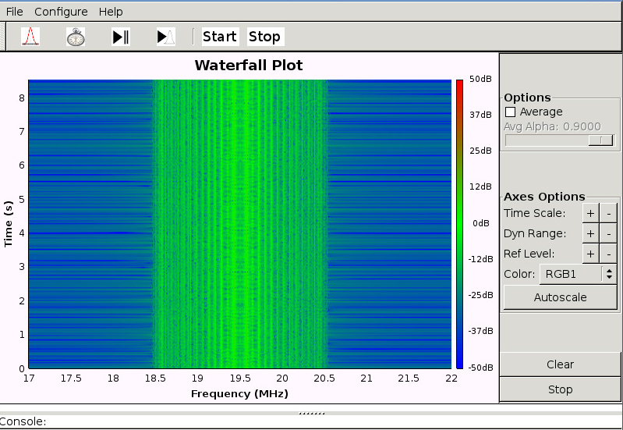
Related Works
Students at the University of Illinois and Grand Valley State University built a software defined radio to listen to emissions from Jupiter by building their own RF section and using GNURadio for the software. This software defined radio was built using an Analog Devices AD9460 and a Xilinx Spartan-3E-500 FPGA to build the SDR itself.
Notes:
While the students in this paper built their own hardware, GNURadio was still used to develop the software. Another goal of this project was to produce a low cost solution using GNURadio.

Slide 9
General Radiometer Theory
The primary goal of a radiometer is to measure power. While that statement sounds easy, there are in fact many factors that go in to how well a radiometer can measure the power it sees. In order to accurately measure power, we need to keep the following in mind.
Total System Noise
Bandwidth of the signal
Stability of the system
Notes:
The primary goal of a radiometer is to measure power. While that statement sounds easy, there are in fact many factors that go in to how well a radiometer can measure the power it sees. A better statement would be that a radiometer’s primary goal is to accurately measure power within a certain degree of accuracy. In order to accurately and within a high degree of precision measure power, a radiometer must take into account various factors such as the system noise, the bandwidth of the signal and the stability of the system as a whole.

Slide 10
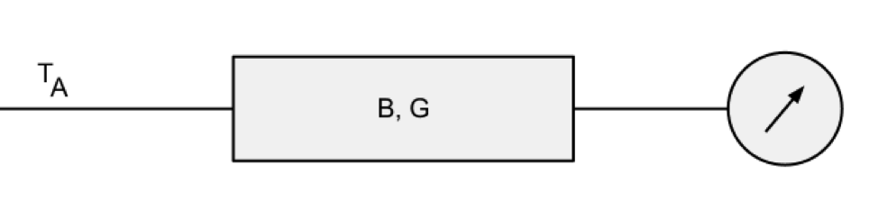
General Radiometer Theory
A very simple and ideal radiometer is an antenna that amplifies a signal with a gain of G and is within a bandwidth of B or β. A device then measures the power from this system. The total power received by the is the noise temperature of the object it is pointed at. Therefore the brightness temperature of the source can be related to the brightness temperature at the antenna. We will refer to this brightness temperature as T_{A}
Notes:
The primary goal of a radiometer is to measure power. While that statement sounds easy, there are in fact many factors that go in to how well a radiometer can measure the power it sees. A better statement would be that a radiometer’s primary goal is to accurately measure power within a certain degree of accuracy. In order to accurately and within a high degree of precision measure power, a radiometer must take into account various factors such as the system noise, the bandwidth of the signal and the stability of the system as a whole.

